Slide 1
Solar Spark
By: Sid Surapaneni, Nikki Aaron, Kevin Hoffman, and Ashley Scurlock

Slide 2
Component Executive summary
Taking into account location factors, weather, solar radiation levels, and average amount of energy used.
we want to build a model that can predict the yearly dollars saved on energy after installing 30 solar panels.
Our supervised model is accurate at predicting this (3% avg error) despite missing variables and not knowing all the equations that govern the result.
Notes:
Component Executive summary: discuss the research question and what you have found

Slide 3
Data journey
To make our dataset for this project we combined both government and private data from seven different sources.
Average Annual Energy Consumption By State
Source: US Energy Information Administration
US Elevation by County
Source: US Geological Survey
Average Monthly Temperatures (℃) By Coordinate
Source: Climatic Research Unit
Cost of Energy by State
($/kWH)
Source: US Department of Energy
Average Monthly Solar Energy Output (W/m²) By Zip
Source: National Renewable Energy Laboratory
Average Monthly Cloudy Days by Coordinate
Source: Climatic Research Unit
Continental US Zip Codes (with latitude and longitude)
Source: SimpleMaps
Final Dataset
Notes:
Ashley
All of the data frames had some kind of location variable (state, zip, county) so we combined them with the US Zip code dataframe
Most of the data transformations was done during this step
Used ball tree to fill in missing information (tree based method, faster than KNN)
We then combined all of the dataframes together on that zip column to create our final dataset.
Data Summary:explain the target (response) variable, the predictors, sampling, etc.

Slide 4
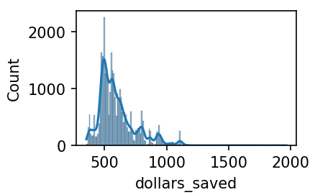
Data summary
Preprocessing
Combined datasets and scaled all of the features except the response.
Response Variable:
Dollars saved is derived from the estimated energy output using 30 solar panels multiplied by the cost of electricity in the area.
Variation Std.Dev. / Mean | Correlations with Dollars Saved
Dollars saved 24% Elevation 125% Temp 37% Energy used 18% DNI 16% Cloudy 12% Solar output 5% | Energy used -0.33 Cloudy -0.23 DNI 0.25 Temp -0.18 Elevation 0.14 Lat 0.15 Lng -0.11
Notes:
Nikki
Data Summary:explain the target (response) variable, the predictors, sampling, etc.

Slide 5
Models constructed
Linear Regression
Baseline model for benchmarking
Random Forest Regression
Ensemble of decision trees
Great for non-linear relationships
Gradient Boosted Trees
Best model
One drawback is long training times
Notes:
Kevin
Linear regression
Fit as a baseline model and used as a benchmark to compare more advanced methods to.
Random Forest Regression
Ensemble method of decision trees. Reduces variance by fitting many trees independently and averages the result from all the trees
From our EDA, features looked to have a non-linear relationship.
- GBT
Also uses decision trees but builds them one at a time improving upon the previous tree
Best performing model
Took 2 hours to train; much harder to tune

Slide 6
Model performance
Model Name | Linear Regression | Random Forest Regressor | Gradient Boosted Trees
RMSE | 109.226 | 54.95 | 39.59
Hyperparameters | MaxIterations: 100 regParam: 0 elasticNetParam: 0 | MaxDepth: 8 numTrees: 250 minInstancesPerNode: 1 | MaxIterations:225 MaxDepth: 7 MinInstancesPerNode: 10
Model Name | RMSE | Hyperparameters
Linear Regression | $109.23 | MaxIterations: 100 regParam: 0 elasticNetParam: 0
Random Forest Regression | $54.95 | MaxDepth: 8 numTrees: 250 minInstancesPerNode: 1
Gradient Boosted Trees | $39.59 | MaxIterations: 225 MaxDepth: 7 MinInstancesPerNode: 10
Notes:
Kevin
We used RMSE as our performance metric
Linear regression was the worst model, RF was much better and GBT was the best at 39
We tuned the GBT with a manual grid search
MaxIterations - number of times to iterate on the tree fitting process -> more iterations, better the model performed
MaxDepth and min instances per node control the depth of the tree
Mininstancespernode prevents the tree from growing too large
Trade off between growing the tree too large leading to overfitting, and underfitting the data

Slide 7
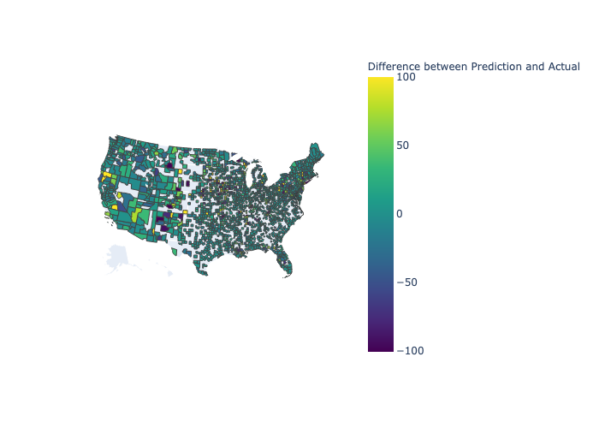
Prediction Choropleth
*RMSE gives a high weight to large errors
Notes:
Sid
-We did a choropleth map to visualize how well our predictions are doing across the country.
-We looked at the difference between predicted dollars saved and actual dollars saved.
Outliers where the error was larger than $300
ISLE LA MOTTE, Vermont
FISHERS ISLAND new york
FAWNSKIN, California
BLOCK ISLAND, Rhode Island
We noticed through this map that the RMSE was giving high weight to large errors.

Slide 8
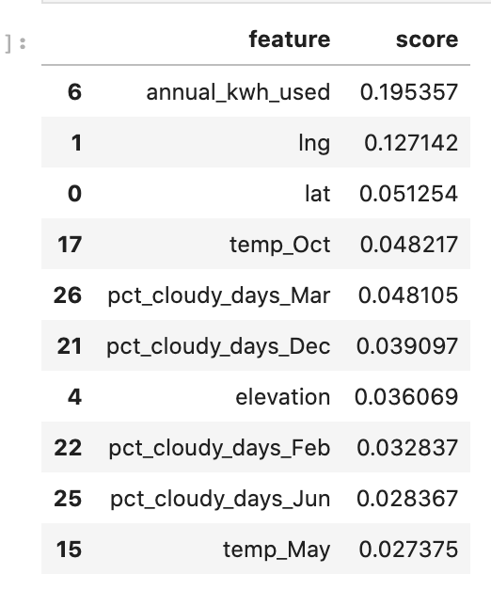
Conclusions
The RMSE was sensitive to high errors. MAE was 18.11.
Among the models tried out, the gradient boosted model had the most effective performance at predicting the dollars saved
Feature Importances of Gradient Boosted Trees Model indicated that factors related to consumption and location(longitude, latitude) were important predictors for dollars saved
Longitude and Annual_kwh_used also had highest feature importances in the Random Forest Model
Future work can involve using more updated solar panel data as well as utilizing data from outside of the United States, as well as maintenance cost data of solar panels
Notes:
When looking at the predictions, we noticed that the RMSE was sensitive to high errors and so we looked at the mean absolute error and our MAE was 18.11. Among the models tried out, GBT was the most effective one. When assessing the feature importances of the model, we saw that factors like annual kilowatt hour used as well
as factors like longitude and latitude had the highest feature importances.
The solar panel model(Canadian Solar CS5P-220M (220W) model) we got data from was discontinued

Slide 9
Thanks!

